Slide 1
Workshop in Data Science
Prof. Daniel Deutch
Omer Abramovich

Slide 2
Data Science
In one sentence: gain insights from data
Either explain a phenomenon or trend or predict them
Typically both
Techniques include a mix from databases/data mining, Machine Learning and statistics
Considered an interdisciplinary profession
Somewhat of a buzz word, but one that is very hot in industry

Slide 3
DS Workshop
The idea is to give you a taste of this important area
Unlike a regular course, you learn ``hands-on”
Requires a lot of work, a lot of self-teaching
We are here to guide you
But it is your responsibility to push things forward
We have some checkpoints in the schedule, but do not rely only on them!
Make sure to have a viable plan and get our advice

Slide 4
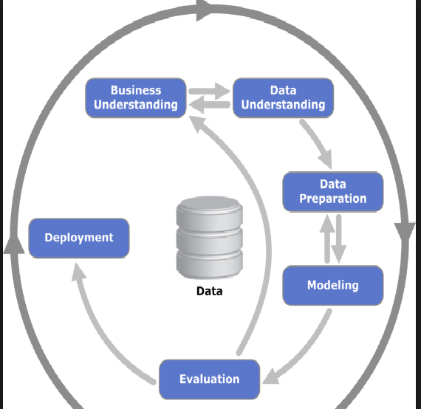
Basic components
Source: Wikipedia

Slide 5
Basic Components
Business understanding, goal identification
Getting and understanding the data
Data preparation
Visualization (optional, yet often useful)
Modeling
Feature Engineering
Choice of (ML) Algorithms
Initial Parameter Choice
Model Training
Evaluation

Slide 6
More details
Identify a “Business” goal
In companies: something that can bring value,
usually monetary, to the company
Forecasting demand
Identifying fraud
Explaining server failure
Forecasting user clicks
In this workshop: something that you find interesting!

Slide 7
Exploring data
Find an appropriate dataset and explore it
Start by “looking” at it (e.g. open a portion in Excel)
Schema
Data quality
Availability
Need for integration
Apply some basic analysis
In particular, basic feature extraction
Represent each data item as a vector of features
To begin with, features can simply be the basic table columns
Visualization helps!

Slide 8
Data Preparation
Types, format
Data Integration (if needed)
Data Distribution
Correlations
Outlier Detection
Data Cleaning
Missing values (NULLs), outliers/errors
Normalization (scaling)
Time consumable, not great fun, but highly important!
Claimed to consume 80% of data scientists time

Slide 9
Data Integration
If data originates in multiple sources, it will probably not be aligned
Attribute names may be different
(pname vs. personname, pid vs. personid)
Format may be different (DD/MM/YY vs. DD/YY/MM)
Structure may be different (by id vs. by name)
Schema matching
Some old but good surveys of basic techniques:
http://dbs.uni-leipzig.de/file/VLDBJ-Dec2001.pdf
http://disi.unitn.it/~p2p/RelatedWork/Matching/JoDS-IV-2005_SurveyMatching-SE.pdf

Slide 10
Data Distribution
Apply statistical tools to the data to identify its distribution, correlations between items
An important case is that of time-series data
Show how data evolves over time
Seasonality is common, needs to be accounted for
In general, knowing the distribution is important
For prediction of new data points
For outlier detection
Types of correlations
Pearson, Spearman, Kendall’s tau,
Important to identify correlation between features (e.g. based on Mutual Information - entropy)
Will be highly useful for the model generation phase

Slide 11
Distribution
Mean, median, most common value
Skewness and Kurtosis
Respectively, how assymetric or peaked relative to the normal distribution is the given distribution
Testing the distribution
Q-Q plot, Kolmogorov–Smirnov test, others
Other methods you have learned in Intro to Statistics

Slide 12
NULLs)) Data Cleaning
Nulls are not uncommon
Indicate missing information
Trivial to identify
How to handle?
Remove/ignore the entire entry
Sometimes OK, sometimes too brutal, depends on how many NULLs there are and on whether their distribution is skewed
Complete based on:
Correlations with other attributes (in turn learned for data items where the value is not NULL)
Interpolation based on the distribution or similar records
Sample based on the distribution

Slide 13
Data Cleaning (outliers)
Much harder to identify, or even formally define
Generally, look for points deviating from the data’s general distribution
Multiple outlier tests
Grubbs, Dixon’s Q-test, Rosners (look it up)
Clustering-based
Single vs. multiple outlier detection, univariate vs. multivariate distribution
Many tools for R, Python, and others

Slide 14
Data Cleaning (outliers, cont.)
Once identified, what to do with outliers?
If there are few, check them (if very few, do it manually)
If seem like errors, simply discard
Otherwise may need a special treatment or adapting the distribution
If there are many, perhaps the inferred distribution was not correct
Apply tests

Slide 15
Normalization
For many ML algorithms to work properly, need to have a uniform scale for all attributes
Simple methods
Normalization to [0,1] (x-min) / (max-min)
Normalization to [-1,1] (2x-min-max) / (max-min)
Statistical methods
Z-normalization
log-normalization

Slide 16
Discretization
Some algorithms require discrete values
The actual data may be non-numeric, or numeric but continous
Also called binning sometimes
Equal-length
Based on the distribution
Entropy-based (for non-numeric)

Slide 17
Visualization
It is recommended to plot the data before, during and after preparation
Use R, Matlab, Excel, Python libraries, or any other tool for that
Useful to get a sense of what’s going on
For instance, you may see remaining outliers just by looking at the data!
Eventually, also highly useful for your customers

Slide 18
Modeling
Feature Engineering
Choice of (ML) Algorithms
Initial Parameter Choice

Slide 19
Feature Selection and Engineering
Feature selection
Goal: choose a subset of the features/attributes of the data
Which of the attributes of the input are important for your goal?
Which of the attributes have discriminatory power?
Feature Engineering
Generation of new features through transformations on the data

Slide 20
Training, Validation and Test set
Common practice to divide the data to training , validation and test set
Training data is used for feature engineering (and later model parameter inference)
Validation set is for parameter tuning
Test set is only for testing (no further model changes, in principle)

Slide 21
Feature selection
Can roughly be divided to methods that:
Look only at the data, and agnostic to the learning algorithm, and
Those that look also at the learning algorithm
Filter Method
Example: Look for correlations between features and the output in the training set
Wrapper Method
A ``wrapper” over the learning process
Keep attributes that have a significant impact on the output

Slide 22
Feature Engineering
Transform the features into “meta-features” that better reflect some properties of the data
Examples
Very simple: pair features together
Complex (and much more useful):
Principle Component Analysis (PCA)
High level idea:
Convert a set of observations into uncorrelated “Principal Components”

Slide 23
Modeling
Applying algorithms, mainly from ML, to generate a model
You have, or will, learn many ML methods in the ML course, e.g.
Clustering
SVM
Kernels
PCA
Regression
Decision Trees
Propbabilistic Models
All have some explanatory nature, but (expect for clustering) are geared towards prediction
Important type of predictors: classifiers

Slide 24
ML and this workshop
In the ML class you will learn the internals of these methods and algorithms
Here you only need to use them as black boxes (tons of available implementations), BUT
You DO need to know what they do, so you can choose what to use
Omer will overview some methods
You will need to go deeper on your own
We’re here to support you

Slide 25
Validation and testing
Extremely important!
Hold-out validation: training-validation-test method
How to split into these 3 sets?
Split may be random, but beware of bias
Example: Seasonality

Slide 26
Cross-validation
Partition the data to k parts
In the i’th iteration, train on all except for the i’th part
Advantage: we do not “lose” data for the learning phase

Slide 27
Predictive Models)) Measures
True Positives (TP), False Positives (FP), True Negatives (TN), False Negatives (FN)
Precision = TP/(TP+FP)
Recall = TP/(TP+FN)
Need to balance between the two, e.g. optimize the F-measure

Slide 28
Subtle Pitfalls
Unbalanced data
Trying to predict if a patient has a very rare disease, 99% can be achieved by saying “NO”
“Curse of dimensionality”
High-dimensional data tends to be very sparse
Typical solution: Dimension reduction through feature engineering
Seasonality

Slide 29
Workshop
Course website in moodle
Forum in moodle
Projects in groups of 2/3, group size
Office Hours: Omer Monday 11-12, Daniel Sunday 10-11, must email first:
Daniel: danielde@post.tau.ac.il
Omer: omera1@mail.tau.ac.il

Slide 30
Projects
First task: form a group of 2 or 3 and register the group by upcoming Sunday
Submission of group member names+id in text file via moodle (only one group member)
First, highly nontrivial real task: define the project goal
Choose tabular dataset from either
World data bank http://datacatalog.worldbank.org/
Kaggle https://www.kaggle.com/datasets
Look for datasets that is potentially extensible by other web sources, possibly non tabular
Overall: at least 4K records
Define a task: if you use the kaggle dataset, your task should be a variant of the kaggle task, not precisely the same one
Your project must include a significant component of at least two areas out of data analysis/cleaning/integration, plus smart use of ML models
You will need to show iterations of improvements

Slide 31
Tentative Timeline: may change, and attendance will still be mandatory!
Attendance is mandatory up to Miluim, doctor’s note, etc.
Next two meetings (3.11,10.11): we teach
17.11,24.11: you present (well thought) ideas
Including feasibility assessment, expected timeline, work plan, etc.
Then you work on the approved idea, ask for our advice as needed
15.12,22.12:you present (checkpoint)
By then we expect to see a significant working component
19.1 and/or 22.1: you present (final up to debugging)
At least some use cases that work well and you can present
15.3: project submission
Full fledged, working and debugged project

